Slide 1
Choric Kidny Disease Prediction

Slide 2
TABLE OF CONTENTS
01
02
03
04
Introduction
Data analysis
About Choric Kidney Disease
What did we do and why?
What did we find and how did we do it?
Data Modelling
Conclusion
Steps and findings
What could be done next

Slide 3
01
Introduction

Slide 4

Chroric Kidney Disease
Means your kidneys are damaged and losing their ability to keep you healthy.
Ranked 12th leading cause of death worldwide in 2017
An estimated 1 in 10 people worldwide have CKD
2 main causes: diabetes and high blood pressure
Age, gender and race affect outcome in CKD
Early treatment: lifestyle changes, medications, treating risk factor like diabetes and HBP.
Kidney failed treatment: dialysis and transplant
Notes:
The best treatment of CKD is facilitated by early detection, when the disease can be slowed or stopped.

Slide 5
697.5 million*
Of CKD cases worldwide in 2017
1.2 million*
Deaths worldwide due to CKD in 2017

Slide 6
Problem Statement
How might I be able to use a classification machine learning model to build a prediction model of whether a patient will progress in Chronic Kidney Disease staging.

Slide 7
Overview of the Datasets
Creatinine value of 300 patients taken at a different day
Creatinine
HGB value of 300 patients taken at a different day
HGB
DBP value of 300 patients taken at a different day
DBP
300 Patient’s race, gender and age
Demo Patients
SBP value of 300 patients taken at a different day
SBP
Medications taken by each patient
Medications
Glucose value of 300 patients taken at a different day
Glucose
CKD patient current stage progress
Stage Progress
LDL value of 300 patients taken at a different day
LDL

Slide 8
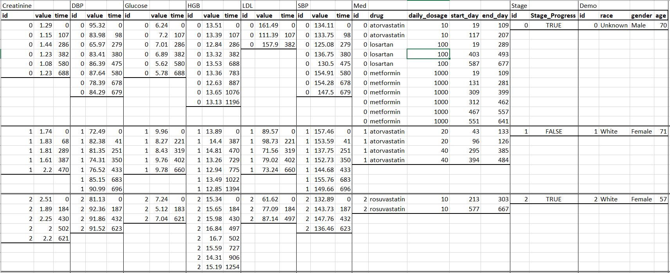
Datasets Sample
Notes:
When I see this datasets, instantly I feel like I have another problem to solve - how can I combine all this information. This is because:
Each patients has different times of value taken.
Each reading has different times of value taken under each patients and the time taken is inconsistent.
Each patients have different drug information, total 21 different drugs.

Slide 9
Creatine, DBP, SBP, Glucose, LDL, HGB
Maximum Value
Mean Value
Latest Value
Minimum Value
Standard Deviation Value
Notes:
I will use the data aggregation (min, max, mean, std) method and the latest value to present each patient data in a summarized format.
With this method, I can include more information about each patient for the machine learning to study.

Slide 10
Medications
Blood Pressure
Cholesterol
Losartan
Carvedilol
Valsartan
Metoprolol
Bisoprolol
Atenolol
Olmesartan
Irbesartan
Telmisartan
Labetalol
Nebivolol
Propranolol
Diabetes
Atorvastatin
Rosuvastatin
Pravastatin
Simvastatin
Lovastatin
Pitavastatin
Metformin
Canagliflozin
Dapagliflozin
Notes:
As for the medication, I will group them into 3 categories: Blood pressure, cholesterol and diabetes. With this, we will able to capture how many different medications taken by each patient.

Slide 11
Estimated Glomerular Filtration Rate
eGFR is the best test to measure your level of kidney function and determine your stage of kidney.
If your GFR number is low, your kidneys are not working as well as they should. Normal GFR is above 90+mL/min/1.73 m
eGFR = 175 x (SCr)-1.154 x (age)-0.203 x 0.742 [if female] x 1.212 [if Black], where:-
eGFR (estimated glomerular filtration rate) = mL/min/1.73 m2
Scr (standardized serum creatinine) = mg/dL
age = years
Notes:
Besides that, I have also created one new feature, estimated glomerular filtration rate.

Slide 12
02
Data Analysis
Let’s see what we found

Slide 13
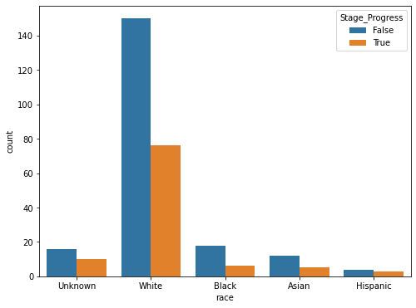
Race
Majority of the CKD patients are White.
True Stage Progress:
White - 76 (34%) out of 226
Black - 6 (25%) out of 24
Asian - 5 (29%) out of 17
Hispanic - 3 (43%) out of 7
Notes:
Majority of the patients in the dataset is White. Seems like the Hispanic has the higher percentage to progress with the CKD in future.

Slide 14
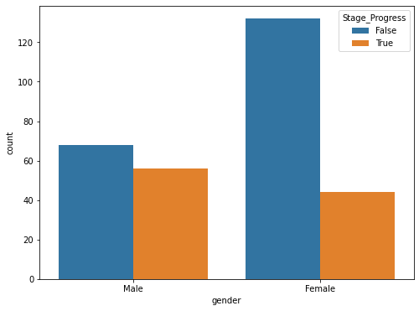
Gender
Majority of the CKD patients are Female
True Stage Progress:
Male - 56 (45%) out of 124
Female - 44 (25%) out of 176
Notes:
From this chart, it tells us that male has a higher percentage to progress in CKD in the future

Slide 15
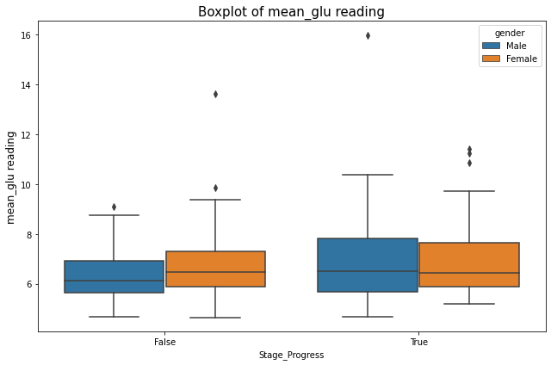
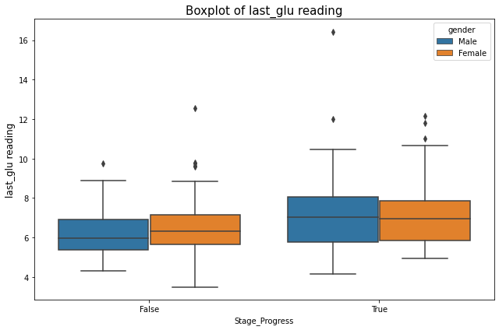
Glucose Reading
Male and Female patients with the True stage progress has higher Glucose reading (based on the mean and latest reading)
Notes:
As I mentioned earlier diabetes and blood pressure are the main causes of the CKD. So we will begin with the glucose reading. Both box plot show that patients with True stage progress still has the higher glucose level.

Slide 16
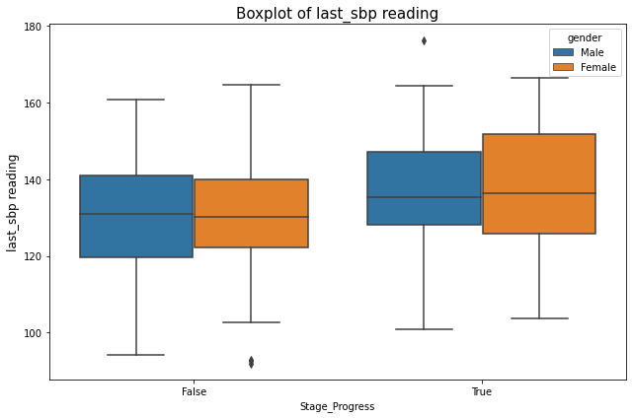
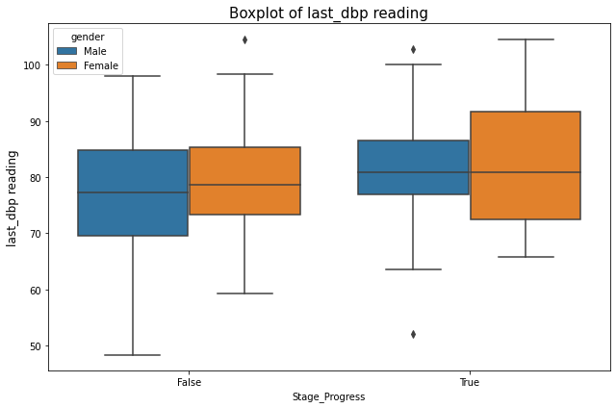
Systolic and Diastolic Blood Pressure Reading
Male and Female patients with the True stage progress has higher SBP and DBP reading (based on the latest reading)
Notes:
Next, we will look at the Blood Pressure reading. So, it proves that patients with higher glucose and blood pressure reading will still progress with the CKD.

Slide 17
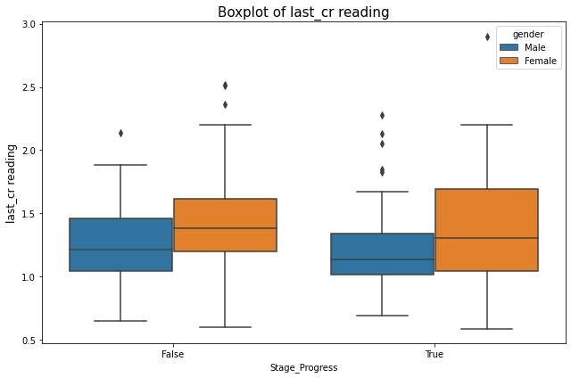
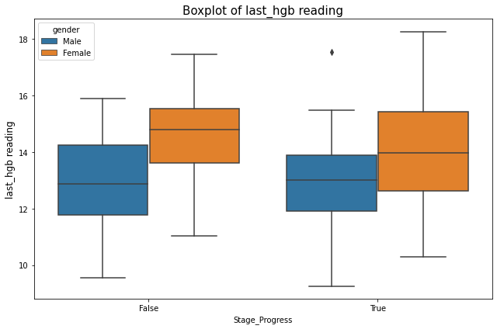
Creatinine and Hemoglobin Level
Male generally has higher creatinine and hemoglobin than Female.
Female patients seem to be higher may be due to irregular periods or earlier onset of menopause.
Notes:
Male generally has higher creatinine and hemoglobin than Female. However, the boxplots show that Female patients seem to be higher.
I think this occurs because CKD cause Female periods to irregular, or dialysis begins that stop her periods altogether, or earlier onset of menopause.
This also tell us that female with earlier menopause increase chances of getting CKD.

Slide 18
03
Data Modelling

Slide 19
Machine Learning Workflow
Final Model
Set metric and Initial Run
01
02
03
04
Prepare Data
Hyperparameter Tuning
Feature Engineering/ Data Wrangling
Train-test-split
Notes:
Now I will explain my machine learning workflow.
First is the data preparation, such as feature engineering and data wrangling that I presented earlier follow by train test split method.
In the second step, I will set the metric for this task and perform an initial run.
After that, I will perform hyperparameter tuning to improve the performance of the model.
Finally, I will select the final model for prediction based on the best metric scores.

Slide 20
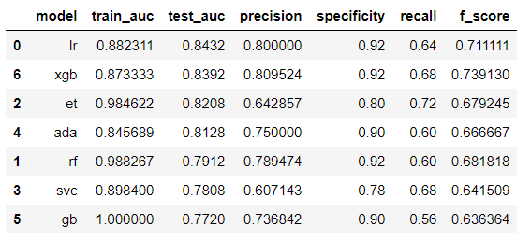
Final Result
Logistic Regression - lr
Extreme gradient boosting - xgb
Extra tree - et
Adaptive Boosting - ada
Random Forest - rf
Support Vector Machine - svc
Gradient Boosting - gb
XGBoosting Classifier is the better model because the difference between test and train AUC is lesser and it has better precision and recall scores which are good at identifying true positives.

Slide 21
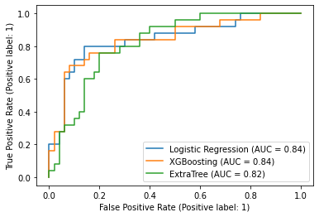
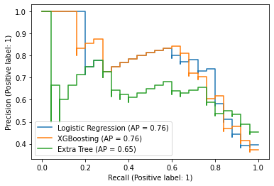
Precision-Recall Curve
AUC-ROC Curve
AUC measure how true positive rate (recall) and false positive rate trade-offs. This reveal how good a model distinguish between positive class and negative class
Notes:
For this problem, I believe that using the Area Under Curve (AUC) as a metric will be an appropriate idea because it focuses on our sensitivity and specificity of our model. To elaborate, AUC measures how true positive rate (recall) and false positive rate trade-off. This reveals how good a model is at distinguishing between positive class and negative class. By analogy, the Higher the AUC, the better the model is at distinguishing whether the patients will progress with CKD or not in the future.
Beyond focusing just on AUC which looks at how good our modelling is at separating our positive and negative class, we also want to pay close attention to our model's ability to classify our minority class (which in this case is our positive class).
Using a Precision-Recall curve, we can look at the tradeoff between a classifier’s precision, a measure of result relevancy, and recall, a measure of completeness.
For diagnostic tests, I think we should first like to know the sensitivity (= recall) because we want to be sure that the test identifies the vast majority of persons with a CKD as having the CKD
Then we would like to know the positive predictive value (= precision) because precision tells us how sure we can be, when we have a positive result, that the person actually has the CKD. Thus, we know how good the test is at discriminating persons with CKD from those without CKD.

Slide 22
04
Conclusion

Slide 23
I am pleased that my model is able to predicts a relatively high level of AUC (0.83), precision (0.81) and recall (0.68) value.
However, I have some concern about model accuracy because of:
Imbalance race, gender and data presented
Number of data point per patient per feature is inconsistent

